Slide 1
TAS152
LECTURE 19
TOPIC 3
TOWARDS A JUST INTERNET
3.4 TOWARDS A REPUBLICAN NET NEUTRALITY

Slide 2

WHAT IS "REPUBLICAN NET NEUTALITY"
This has nothing to do with "republican" or "democratic" in the context of United States politics.
The word "republic" means:
Government controlled by the elected representatives of that country’s citizens.
The word "republican" means:
An individual who is part of the country.
What is the difference between a republic and a democracy?
Republic is ruled according to a charter, or constitution
A democracy is ruled according to the will of the majority.

Slide 3
THE REPUBLICAN APPROACH TO NET NEUTRALITY
What is the meaning of freedom?
Absence of domination, individuals are protected against threats that undermine their freedom of choice.
The republican approach to net neutrality consists of three main elements:
Individual freedom exists in social relationships (individuals, institutions, political communities) and accommodates power imbalances.
Individuals are affected by decisions made by others, but still have right to moral freedom at personal level.
Institutional measures are put in place to protect individuals against more powerful actors who might threaten their freedom of choice.

Slide 4
THE REPUBLICAN APPROACH TO NET NEUTRALITY
1. Individual freedom exists within social relationships …
i.e. anyone is allowed to create a political party, anyone is allowed to start a business.
2. Individuals may be affected by decisions made by others, but freedom at a personal level …
i.e. the selling and distributing of cannabis is tightly regulated, but individuals are allowed to use cannabis at their own discretion without legal recourse.
3. Institutional measures are put in place to protect individuals …
i.e. Politicians are not allowed to bribe people for votes, the basic employment act etc.

Slide 5
THE REPUBLICAN APPROACH TO NET NEUTRALITY
Risks to individual freedom are analysed in terms of
the extent
the intensity
...of the interference with the individual's freedom
extent - how much the individual's freedom has been interfered with.
intensity - how easy it is to interfere with the individual's freedom.

Slide 6
TWO ALTERNATIVES FOR FREEDOM ONLINE
First alternative: Freedom based on non-domination
All individuals are entitled to access online information,
All individuals are entitled to protect their personal privacy
All individuals are entitled to restrict access to their own data.
Second alternative: Freedom based on global governance
Policy-making at an international level to prevent domination of the Internet by powerful entities.
A complex global information ecosystem.
Need a set of universally accepted ethical principles.
Second alternative is the hardest to implement

Slide 7

BLUEPRINT FOR ADDRESSING NET NEUTRALITY
Situation 1: Mitigation of congestion
Traffic management system
Prevent powerful orgs from influencing flow of Internet traffic for their advantage.
Goal is effective functioning of the Internet as a whole.
Address traffic congestion to meet the needs of the widest range of applications
Appropriate prioritisation rules should be applied.

Slide 8

BLUEPRINT FOR ADDRESSING NET NEUTRALITY
Situation 2: Prohibition of access to specific content
Individual freedom of access to information sources promoted at national and international levels.
Not sufficient for only illegal content to be banned
All content uploaded to the Internet should be scrutinised to determine if it fosters non-domination
All relevant stakeholders are given an opportunity to express their views before content is uploaded

Slide 9
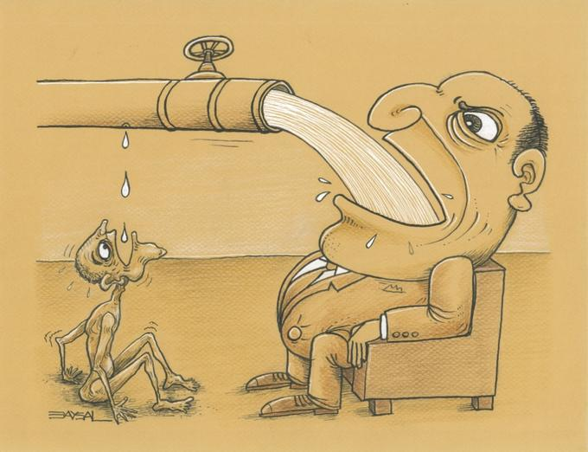
BLUEPRINT FOR ADDRESSING NET NEUTRALITY
Situation 3: Differentiation of services to end-users and the protection of IAPs’ own services
Create a control mechanism
Interests of all users is taken into account when creating the control mechanism
IAPs need to implement the control mechanism

